Slide 1

Representation Powers
and
Mandates
RPaM
DIGIT
3rd Working Group Meeting
21st February 2019

Slide 2

Agenda
RPaM Working Group Meeting #3
Content
Round Table
Meeting objectives
Work done and ongoing
MS-RPaM Mapping
Conceptual Model
Information Requirements and Constraints
Business Requirements and Business Rules
New challenges
Requests to the WG (reminder)
Questions and suggestions (WG members)

Slide 3
1
Round
Table

Slide 4


1
Round Table
DIGIT and MS
everis team
European Commission
Miguel Álvarez-Rodríguez (DIGIT, project owner)
Frédéric Poels (DIGIT, project owner)
Carlos Gómez-Muñoz (DG CNNECT, project owner)
Valentin Mesaros (DIGIT, analyst)
Member States and Stakeholders:
everis
Virginia Gomáriz (client manager)
Rui Venâncio (project manager)
Enric Staromiejski (eGovernment and interoperability)
Laia Bota (semantics analyst)
Danae Djin Ah Armelle Desplanques (business analyst)
Jade Maana (developer)

Slide 5
2
Meeting objectives

Slide 6
2
Meeting objectives
Recap on the previous WG-Meeting
Reminder on the overall objective
On-going activities
Specific requests to the WG members
Questions to the WG members

Slide 7
3
Work done and ongoing

Slide 8
3
Work done: model stabilisation
Mapping the MS information Requirements to the RPaM Ontology:
AT and ES completed
The rest….no models available
Taxud is being proposed to be taken on board
Conceptual Model evolution. Inputs from AT and ES have improved and enriched the models of
Mandate
Request
Response
Agent
Issues created up to now have provided valuable input for:
Governance and maintenance policy
Catalogue of PUC and Exchange Data Model (protocol)
eMandate Versioning

Slide 9
3
Work ongoing: Issues handling
Examples of feed-back with impacts on the RPaM model:
Issue #1, has generated the elaboration on IRCs, PUCs and eAC;
Issue #4, current discussion and analysis on how to apply the eIDAS identifier policy for the eAuthorisation of representatives of natural and legal persons;
Issue #5, puts forward the need for the RPaM UC-01 EDM;
Issues #8 and 9, SEMPER feed-back, will improve considerably the RPaM glossary;

Slide 10
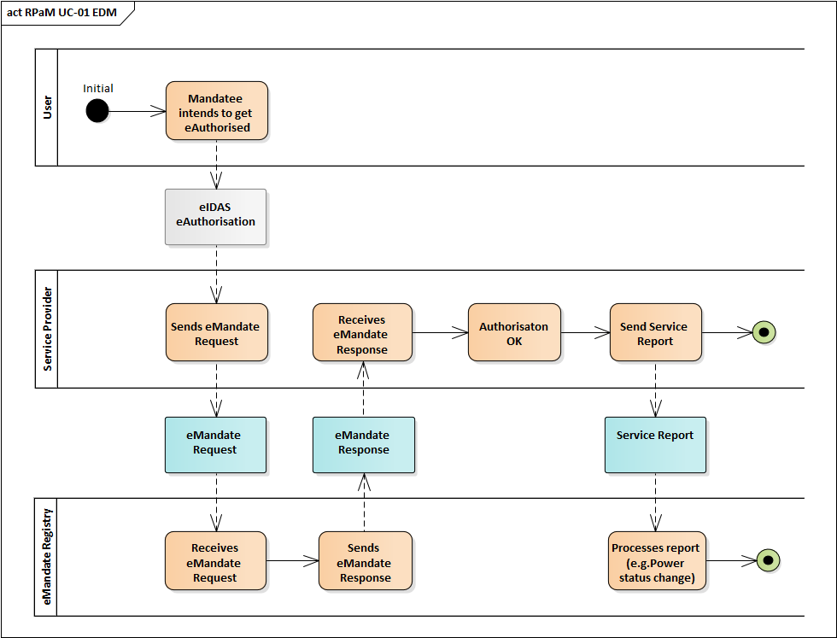
3
Work ongoing: new transactions
The discussions on the issues have also raised possible new transactions, e.g. need for a ServiceReport for notifications back to the eMandate Registry:

Slide 11
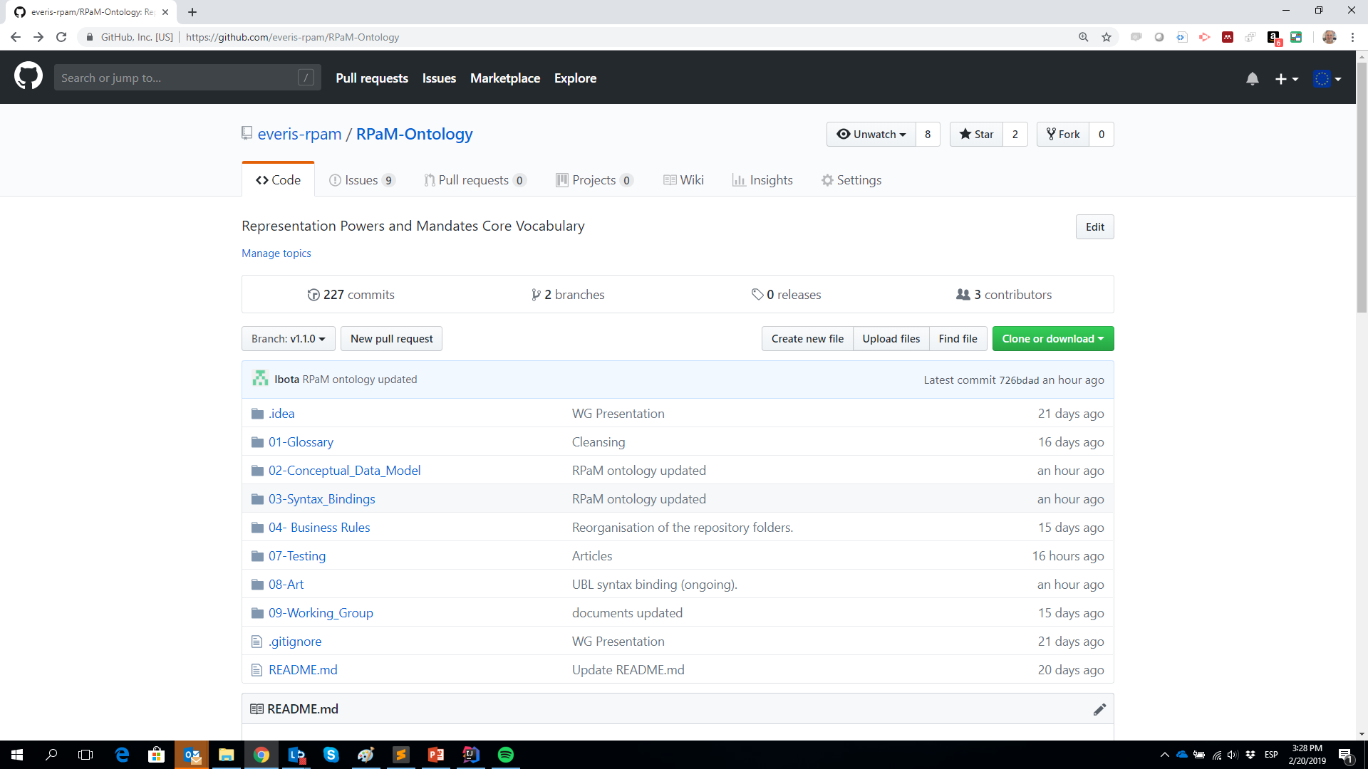
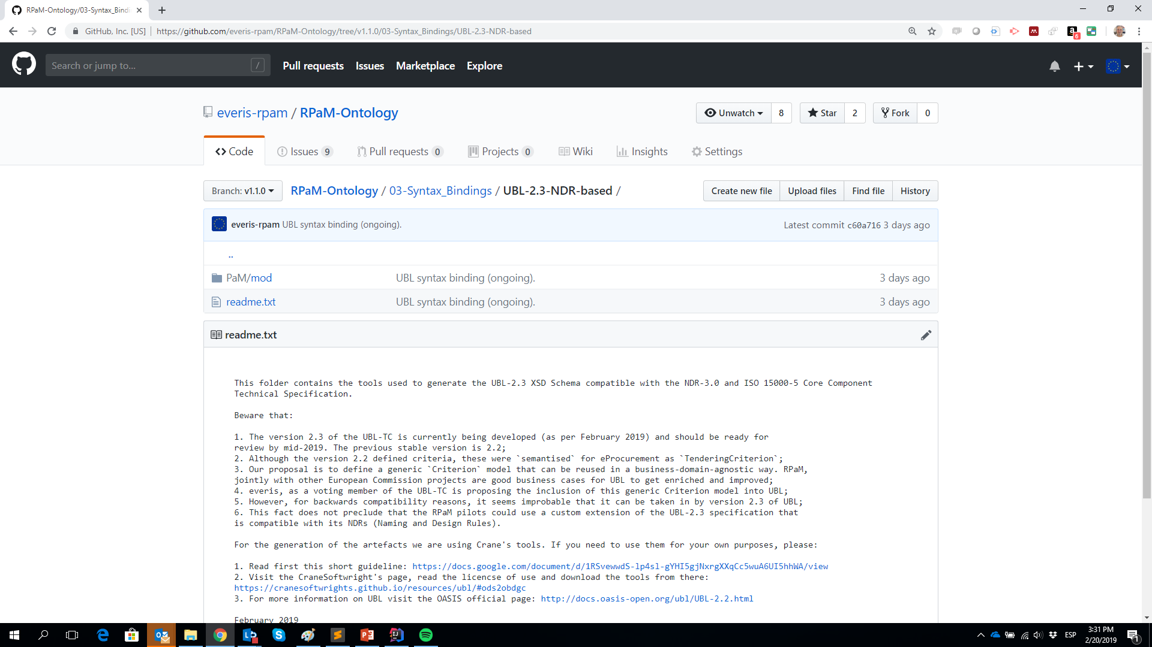
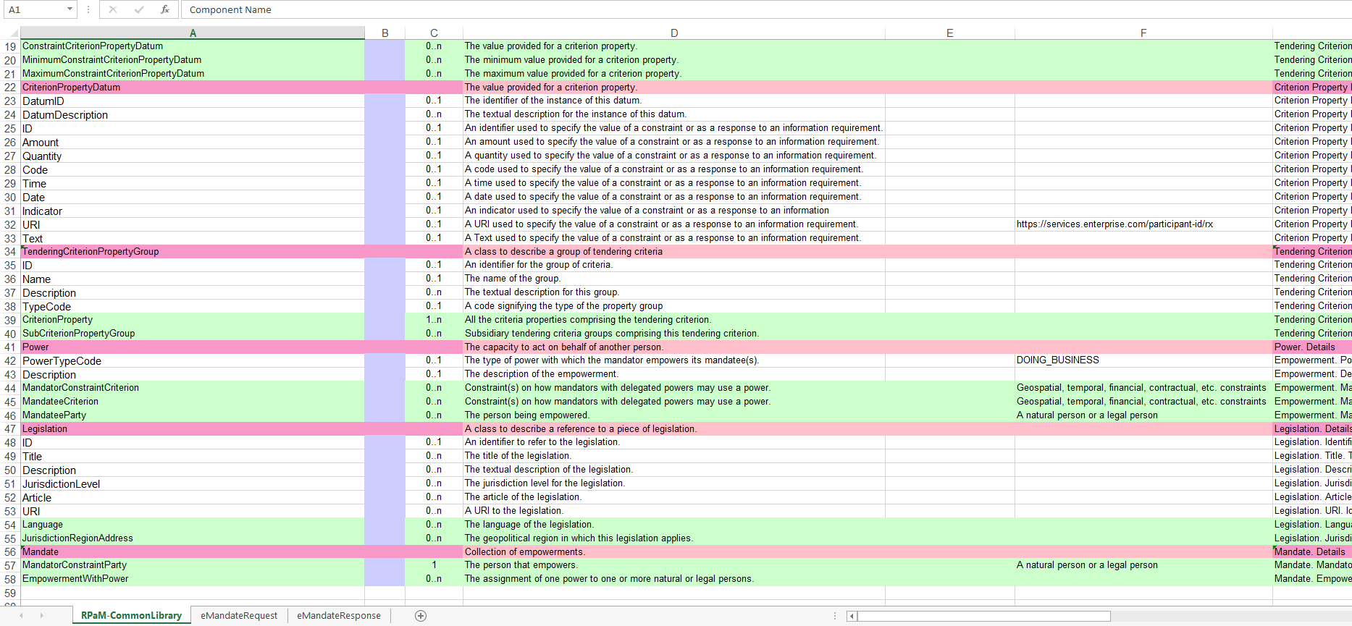
3
Work ongoing: XML Syntax binding
We have re-structured the code repository folder structure
We have started converting (automatically) the RPaM data model into UBL-2.3 NDR-conformant syntax
In the next weeks we’ll provide example XML instances of eMandateRequest, eMandateResponse expressed as UBL-2.3
The final deliverables will include two syntax bindings:
OWL-DL-Turtle (for data integration and user-friendly documentation purposes), and
UBL-2.3 XML artefacts (for real transactions)

Slide 12
4
MS-RPaM
Mapping

Slide 13
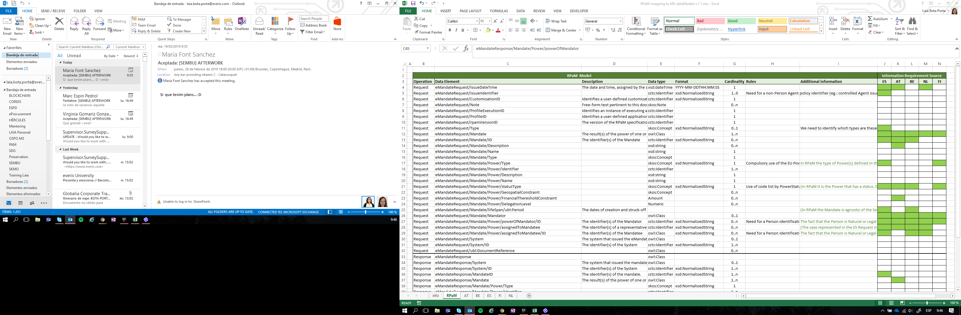
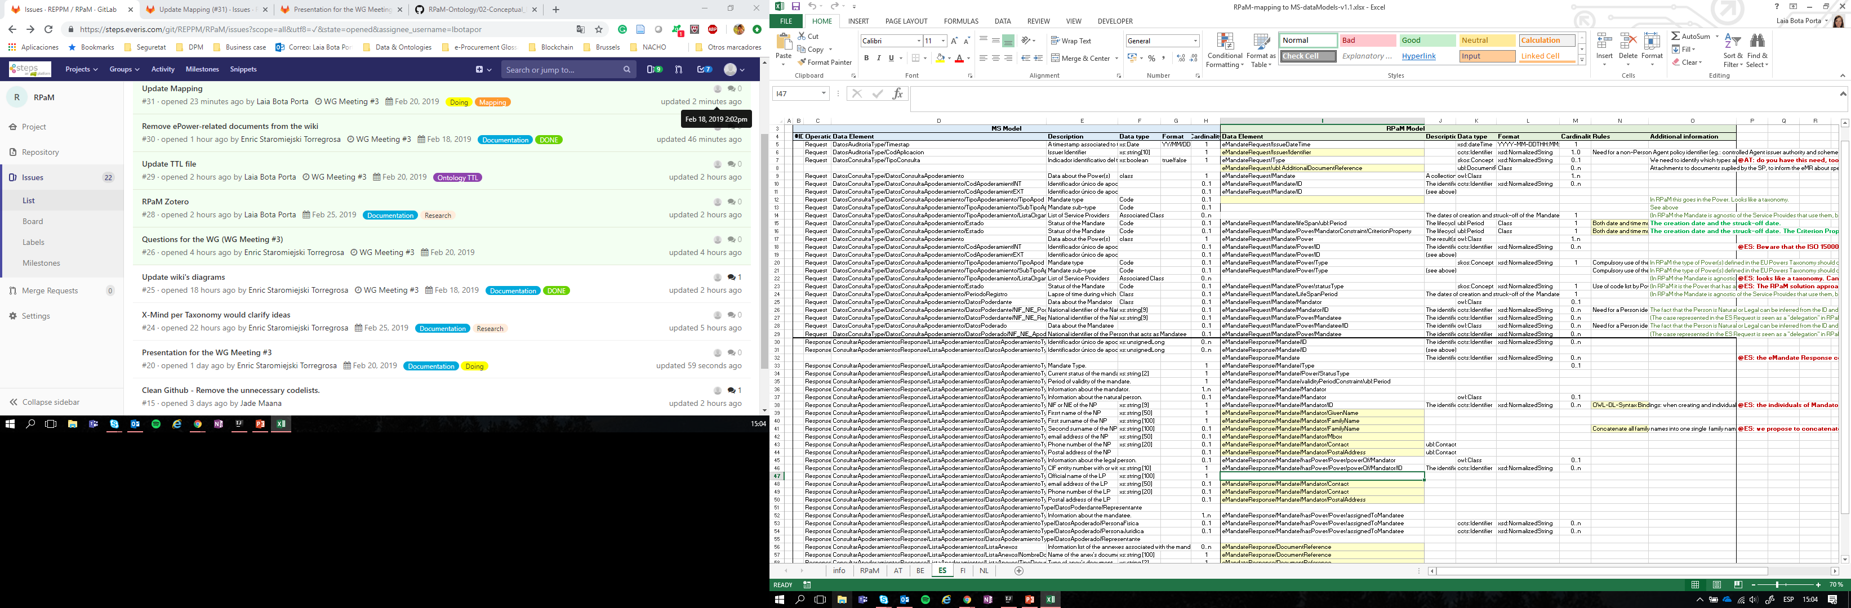
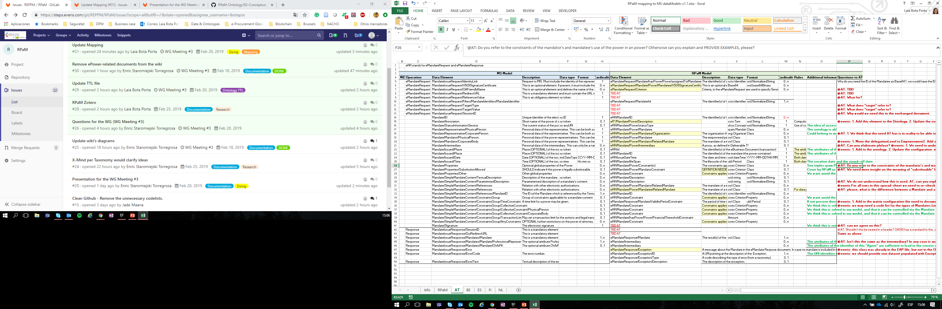
4
Mapping MS-RPaM - IRs

Slide 14
4
Mapping MS-RPaM - IRs
Bilateral discussions held with:
AT and ES
We’d like to have similar bilateral discussions with FI, BE, NL and PT, at least to check with them that the RPaM model caters for their information requirements, constraints, business requirements and business rules.

Slide 15
5
Conceptual Model

Slide 16
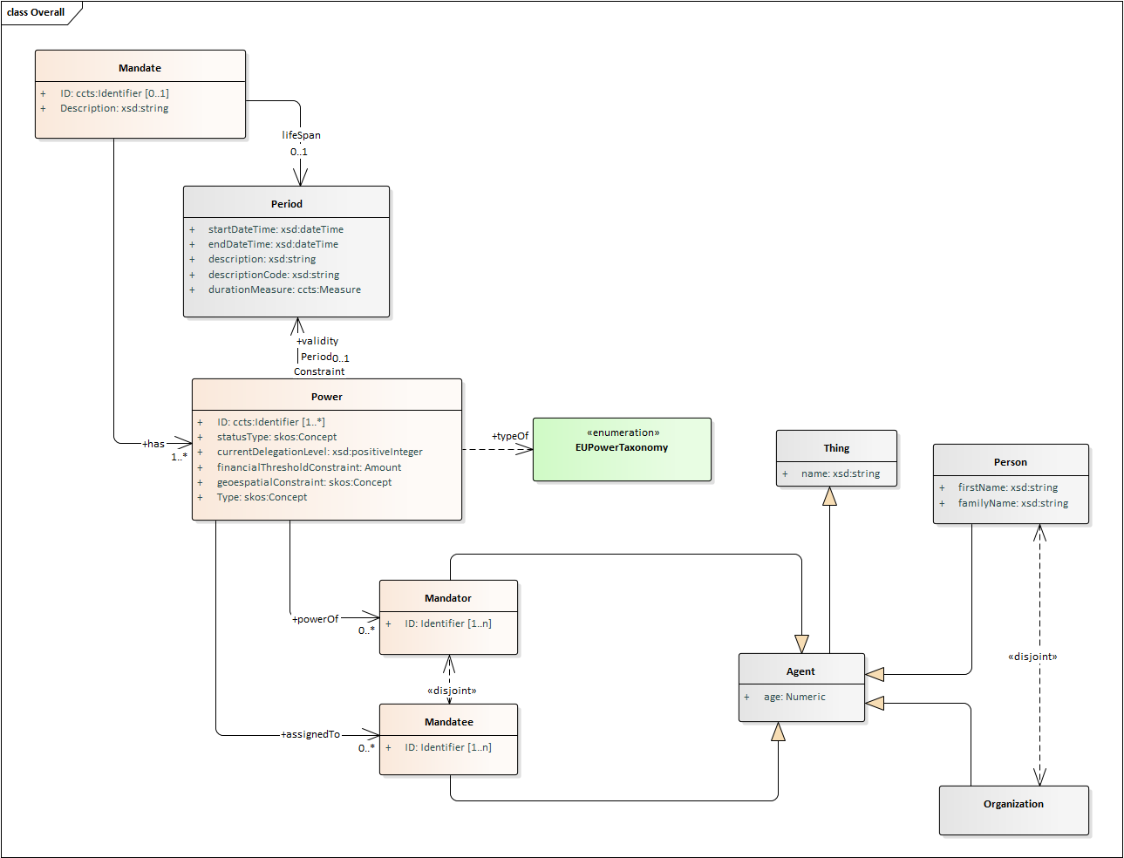
5
RPaM Ontology: previous (v1.0.0)
previous
EAP file

Slide 17
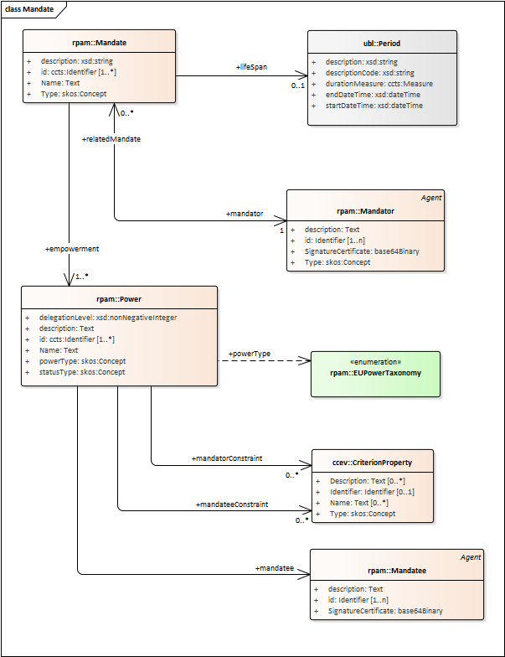
5
RPaM Ontology: now (v1.1.0)
current
EAP file

Slide 18
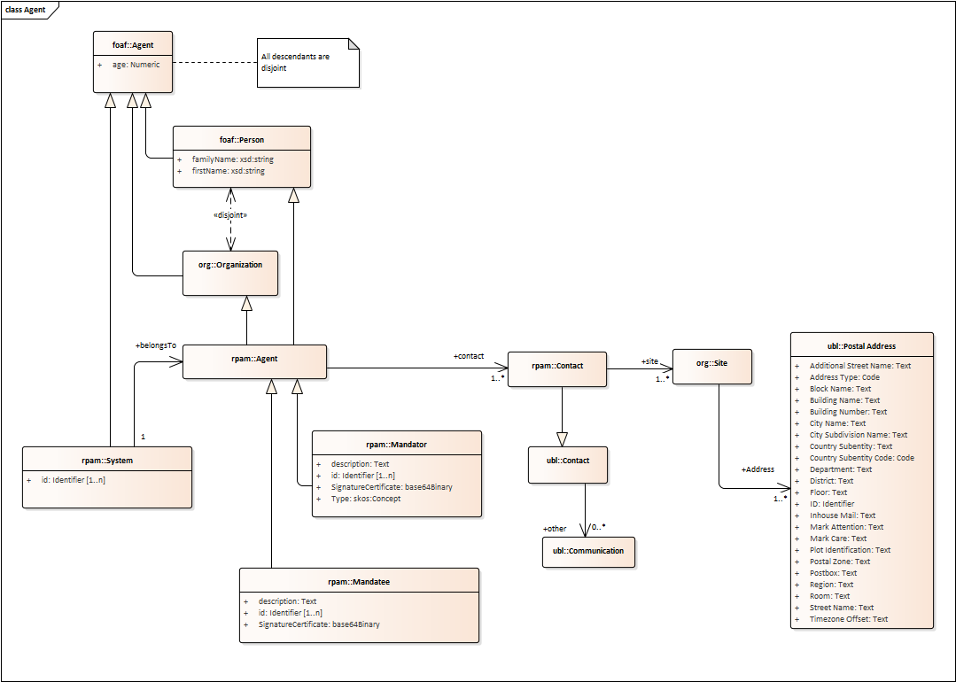
5
RPaM Ontology: Agent

Slide 19
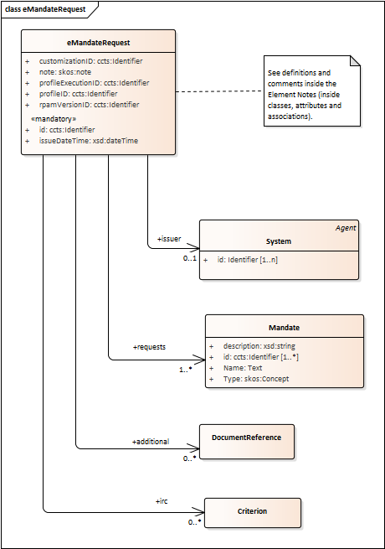
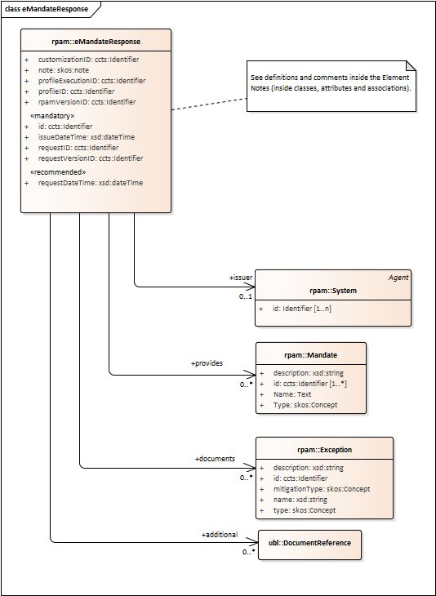
5
RPaM Ontology: eMandate Request and Response

Slide 20
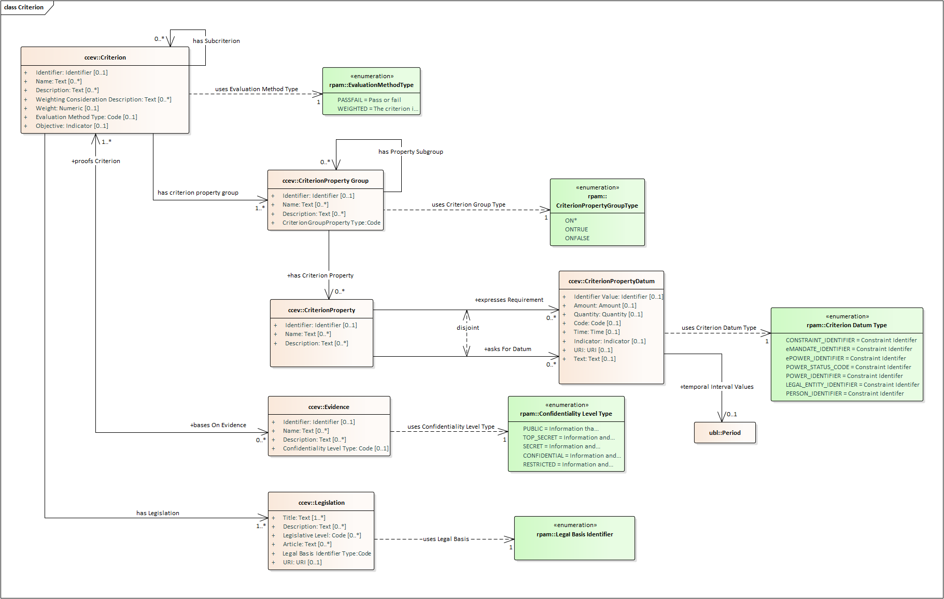
5
Use of the CCEV in RPaM
Reminder

Slide 21
6
IRCs and PUCs

Slide 22
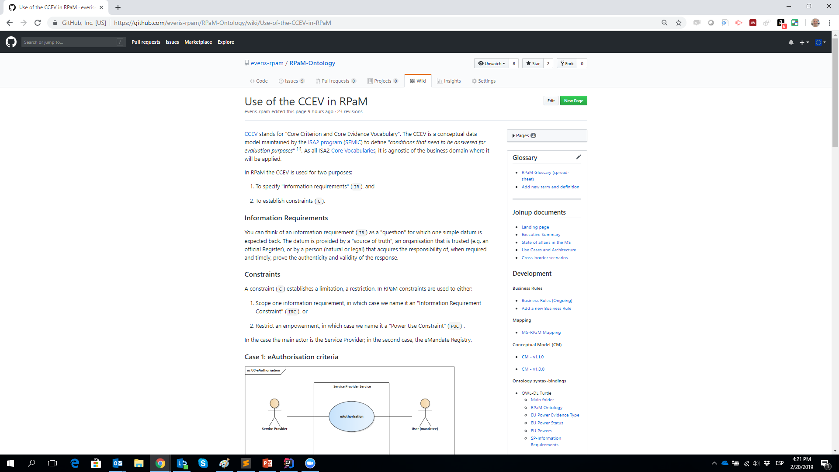
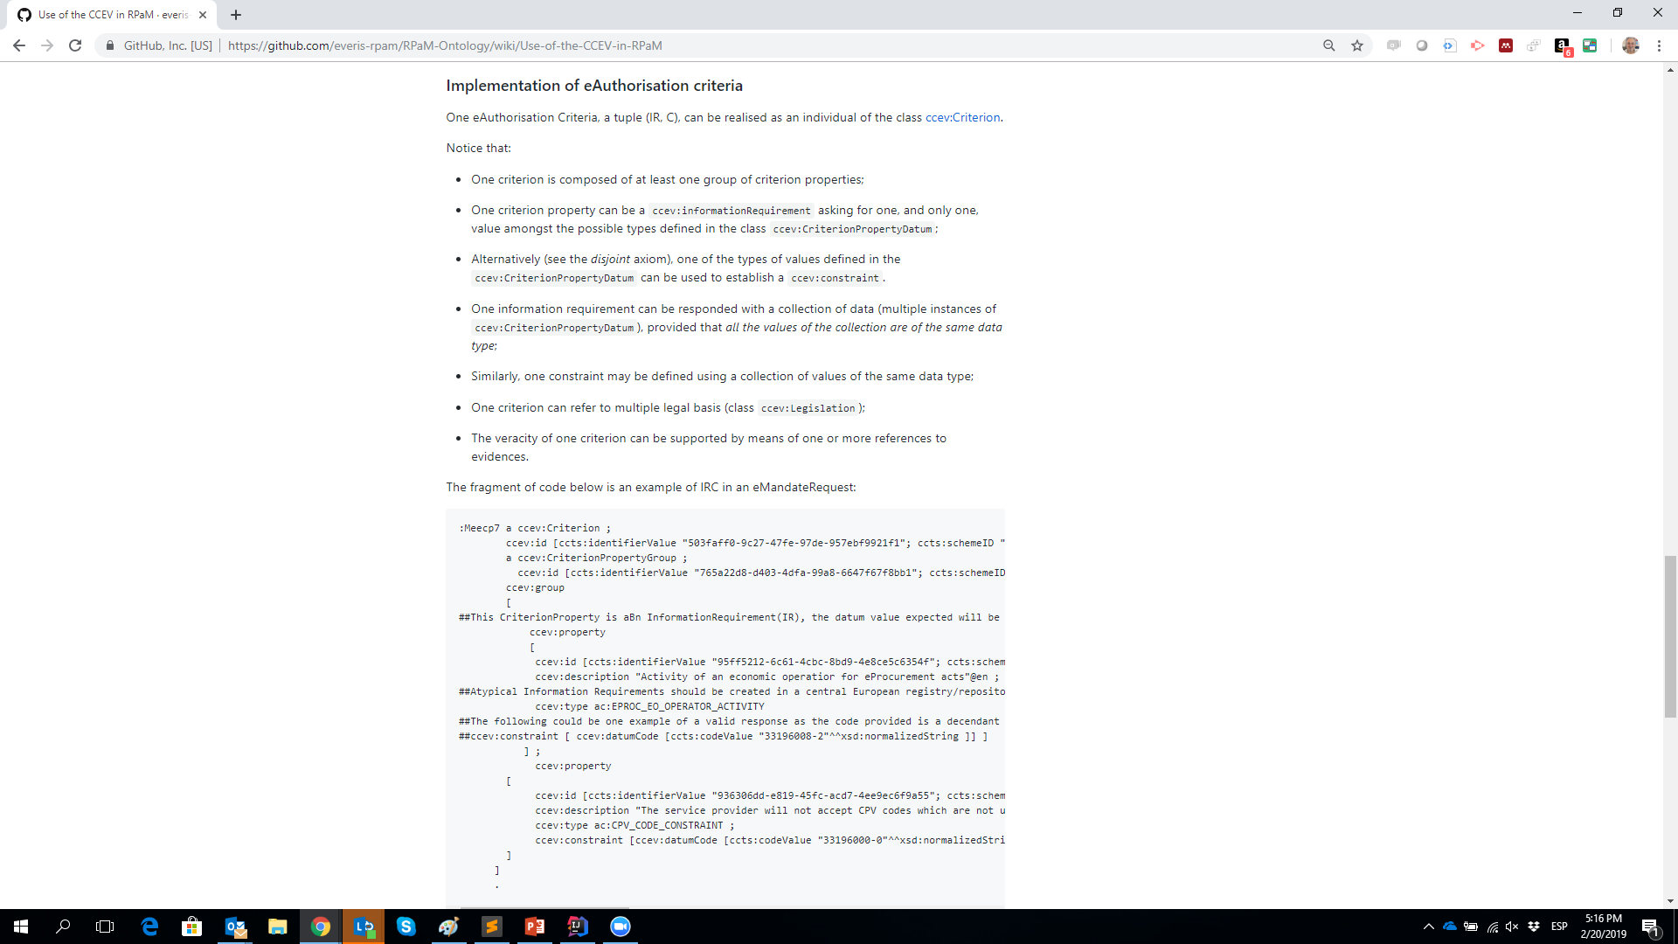
6
Information Requirements and Constraints

Slide 23
7
Needs & rules

Slide 24
7
Needs and rules (reminder)
Need for Identifier Policy
Define/Adopt an Identifier(s) Policy for NP, LG and other entities (e.g. Agents)
Examples:
OpenPEPPOL policy for identifiers (https://peppol.eu/wp-content/uploads/2017/12/PEPPOL_Policy-for-use-of-identifiers-300-11_certificates.pdf)
EMSFEI (https://ec.europa.eu/cefdigital/wiki/display/SDBX/2018/11/23/CEF+eInvoicing%3A+Publication+of+the+Electronic+Address+Scheme+Code+List)
UN/CEFACT code list for Agency IDs (http://www.unece.org/trade/untdid/d08a/tred/tred3055.htm)

Slide 25
8
PUCs

Slide 26
8
PUCs
…

Slide 27
9
WG impact

Slide 28
9
WG members’ impact
…

Slide 29
10
Questions
to the WG

Slide 30
10
Questions to the WG members (1/2)
Synergies with SEMPER?.
Does versioning the mandate content makes sense? This could be needed when the status of a power in a mandate changes.
Do we need a kind of "ServiceReport" document to notify the eMandate Registry about how went the use of a mandate? (e.g., in the case of powers constrained as "OneSingleUse", the eMandate Registry would need to be notified about the successful consumption of the service, so it could change the status of the power.

Slide 31
10
Questions to the WG members (2/2)
One or more Issuer System in the Request and Response:
"Right now we propose to have an "Issuer" System. But a more flexible solution could be to have 1..n Systems involved in the transaction.
Additionally each System could have two properties: role (e.g. creator, mediator, issuer, etc.) and an ordinal number to identify the participation of each system in the transaction creator → 0, mediator1→ 1, mediator2 → 2, issuer-3, thus creating a chain of systems.
Now, is this relevant to RPaM, or this an "internal" affair of the MS that issues the document?
Our proposal: keep it the simplest, one Issuer System.

Slide 32
11
Requests
to the WG

Slide 33
11
Requests to the WG members (reminder)
Please use the GitHub Issues to start new threads of discussion
Use the everis-rpam@everis.com email only for governance aspects (e.g. organising extra-ordinary WG meetings, other…)
Please provide Mandate, Request and Response Data Models (e.g. AT, ES are good examples)
Please provide us with Mandate, Request and Response instance samples (the more the better; we can provide help for data-masking)
Please provide examples of information requirements and constraints that SP impose to access their services.

Slide 34
Next
WG
sessions
11

Slide 35
11
Next WG meeting
14th March 10 a.m. (in three weeks)

